Slide 1
Low Concentration Thin Films with Solar Tracking
Group 11
Amanda Klein
Jesse Trawick
Sean Murphy
Motiur Bhuiyan
Sponsors
Progress Energy

Slide 2
Goals and Objectives
To increase the efficiency of thin film solar panels using solar tracking and optical manipulation.
To create a limited space alternative to roof mounted arrays for individual residential applications.
Provide an interactive user interface for monitoring the power gained from running the array.

Slide 3
To meet these objectives…
The device must:
Occupy relatively low area.
Be self-sustaining; No outside power sources.
Low maintenance; Weatherproofed.
Affordable for residential consumers.

Slide 4
Specifications
Must operate in temperature range of 20ºF to 110ºF.
Must power a 300 watt load for 2 hours continuously.
Must not exceed 4ft x 4ft area.

Slide 5
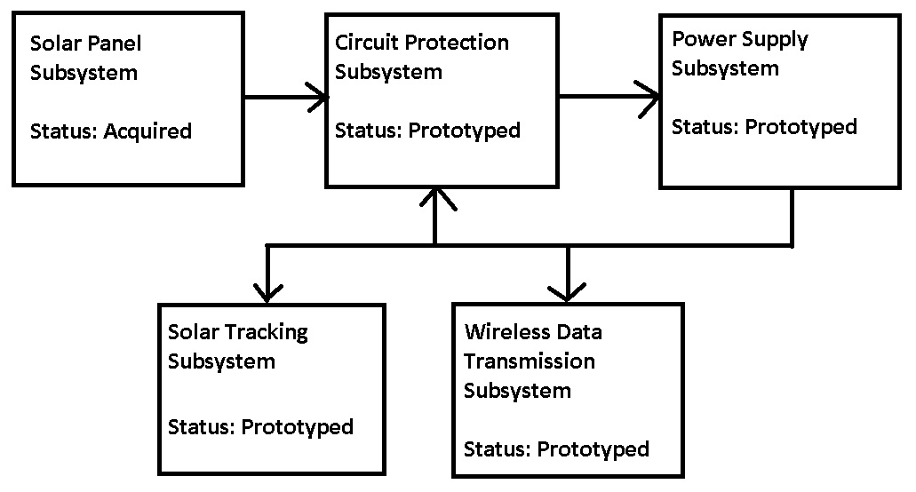
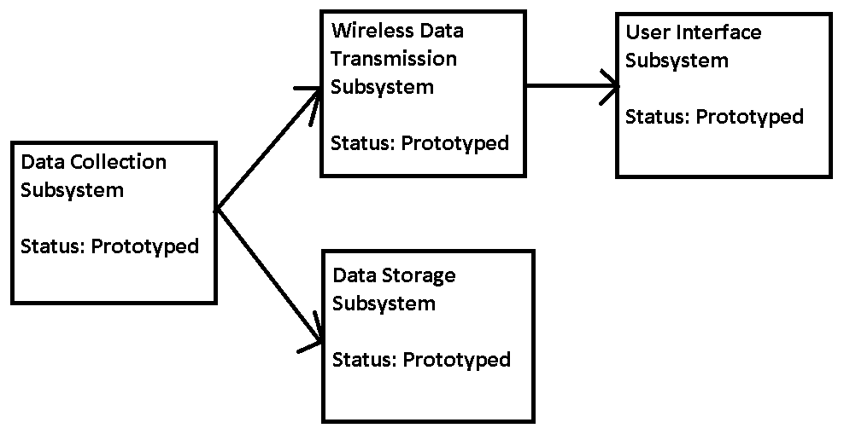
Project Block Diagram

Slide 6
Solar Panels, Tracking and Collection

Slide 7
Thin Film PV vs. Crystalline Silicon PV
Crystalline
Proven Technology
Costly to manufacture
Wafers are thick and bulky
15-20% efficiency with a maximum of 30%
Thin Films
Superior performance in hot and cloudy climates
Utilize rare Earth elements.
Multiple surface options (thin modules)
6-11% efficiency with a maximum of 21%

Slide 8
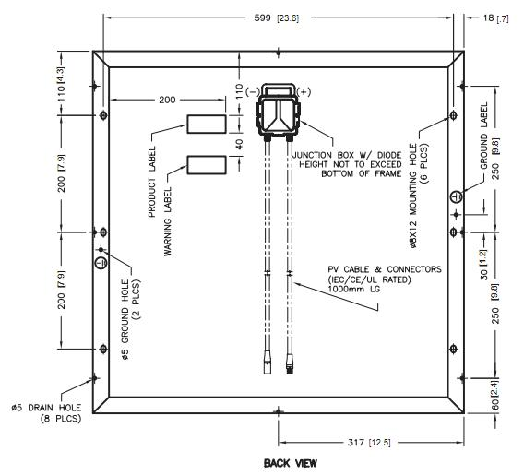
GSE 30W 12V Thin Film Solar Panel
Maximum power: 30W
Current at Operating Voltage: 1.7A
Operating Voltage: 17.5V
Temperature Coefficient for Power: -0.5% / °C
Temperature Coefficient for Voltage: -0.5% / °C
Cost $179.99

Slide 9
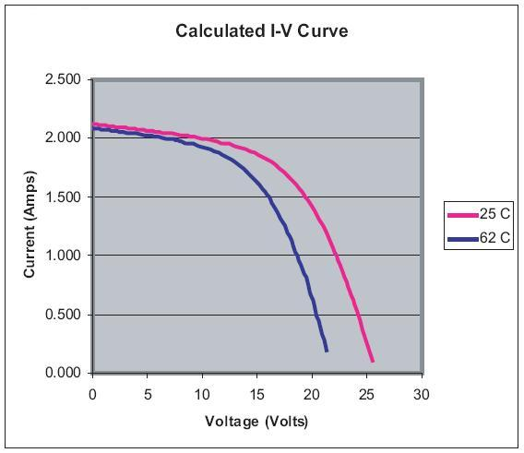
GSE 30W 12V Thin Film Solar Panel
High power output at higher temperatures.
At 77°F, power output is 30.63W, versus 26.25W at 144°F.
I-V Curve for GSE Solar 30W Thin Film Solar Panel

Slide 10
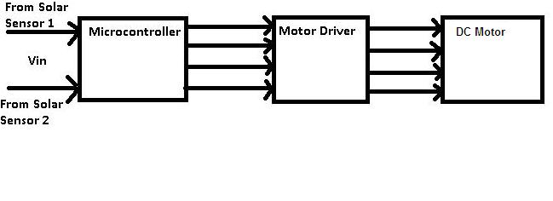
Solar Tracking Motor and Sensors
Microcontroller (PIC18F4520) chosen since I have some in stock and codes with C.
Chose the L298 driver for its high voltage range and built in logic.
Motor will be chosen on ability to rotate roughly 30lbs.

Slide 11
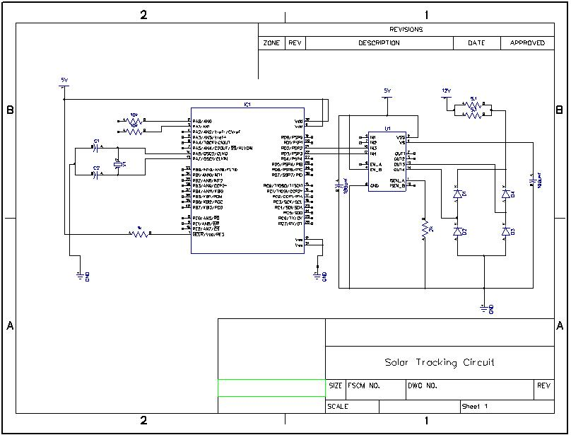
Solar Tracker Schematic

Slide 12
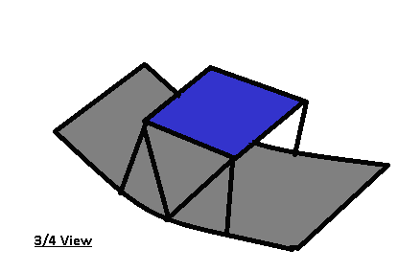
Solar Collector
Trough Design – Simplest and cheapest to implement.
If trough is twice the area of the panels, exposure breaks even.
Plastic paneling support with highly reflective Mylar covering.
Panels oriented back to back. This will test gain with and without solar collection at the same time.

Slide 13
DC/DC Converter

Slide 14
DC/DC Converter Goals and Specifications
Must provide protection from overcharging and back current into the panels.
Converts a 35V input to a 24V output.
Main lines must operate at around 2A while in full operation.
Must transmit >90% of power from panels to batteries.

Slide 15
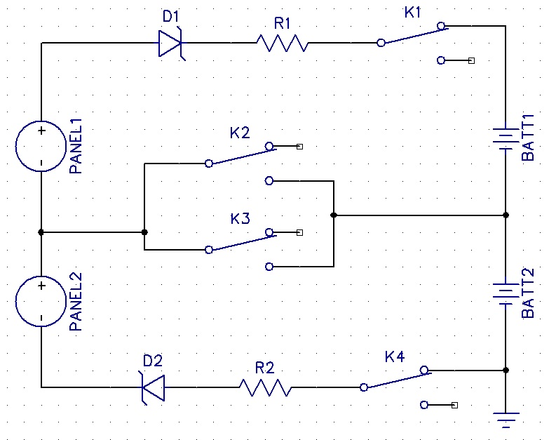
DC/DC Converter Main Lines

Slide 16
Components Used in Main Lines
TX Series DPDT 2A Relays – Compatible with TTL logic (3.38V energized state); One relay controls 2 switches, reducing logic.
500mV Schottky Diode – Low forward diode drop; reverse breakdown voltage exceeds our voltage range; 2A current rating.

Slide 17
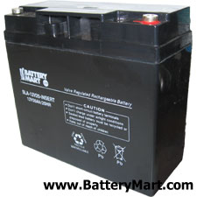
Battery Selection
SLA-12V 18AH
SLA Technology – Simple to charge, mature technology, weight not an issue
18AH Capacity
24V System (2 batteries)
For our specifications, capacity is roughly 13AH for a 24V system.

Slide 18
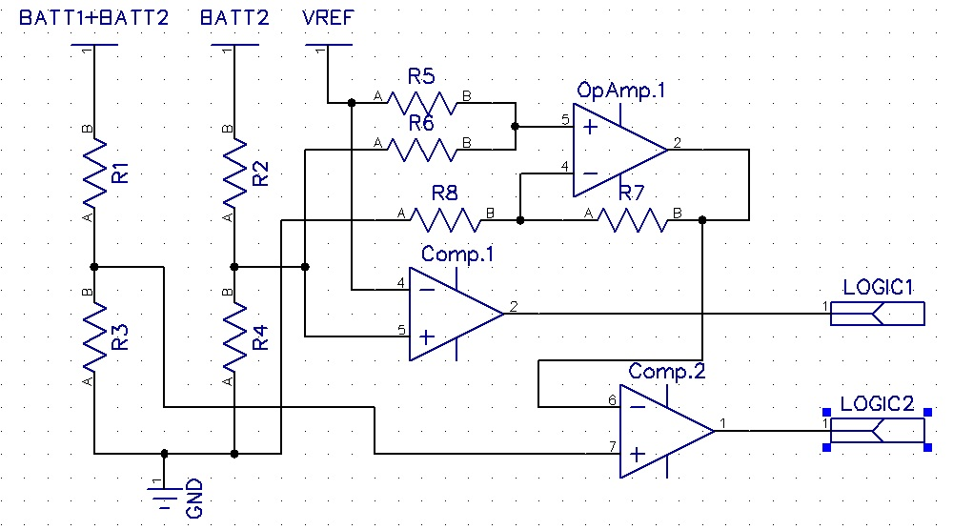
DC/DC Converter

Slide 19
Components Used In Relay Logic
LM124 – Low Power Quad Operational Amplifier: 0-36V Single Supply; Also used as unity gain buffer for V sensors.
LM139 – Low Power Quad Comparator: 0-36V Single Supply; capable of producing TTL logic.

Slide 20
Relay Driver + Logic Outcomes
Table 1 – Summary of Relay Logic
DS26C31T – CMOS Quad TRI-STATE Line Driver: Has 2 outputs (one inverted) for every TTL logical Input. Output current of 150mA per pin.
Logic1 | Logic2 | K1 | K2 | K3 | K4
L | L | Closed | Open | Open | Closed
L | H | Closed | Open | Closed | Open
H | L | Open | Closed | Open | Closed
H | H | Open | Closed | Closed | Open

Slide 21
DC/DC Converter Main Lines

Slide 22
Power Systems

Slide 23
Power Systems Goals and Specifications
Provide power for all integrated circuits.
Convert power from DC/DC Converter to US standard AC for use on load.
Supply voltages of +16V and +5V DC to integrated circuits.
24V battery/inverter system to supply 300W to test load.
>90% Efficiency
Runs load for 2 hours continuously.

Slide 24
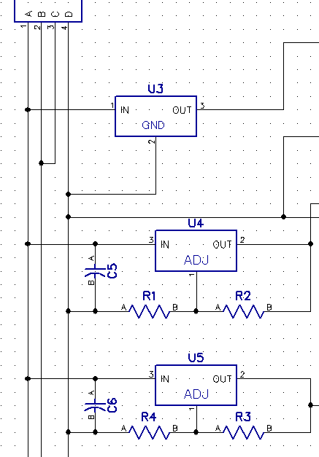
Power Supply Schematic
LT317 Adjustable Linear Regulator: 4V to 36V input, 0V to 24V output. Used to get +20V supply and Vref.
LM7805 5V Linear Regulator: Use to power Integrated circuits.

Slide 25
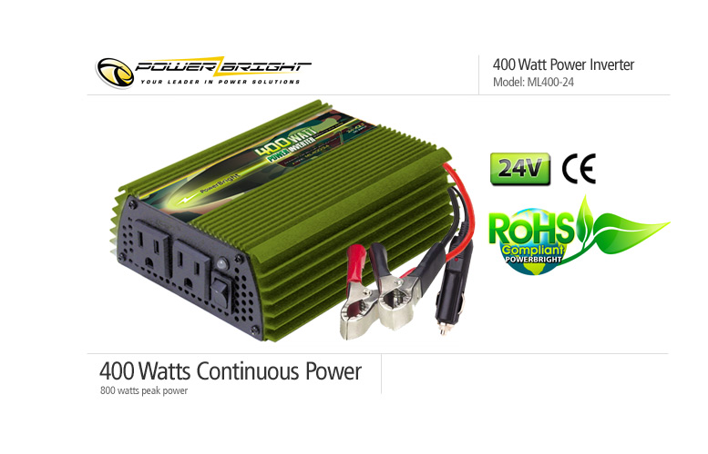
Inverter
Powerbright ML-400-24
24V Input
400W continuous: Meets requirement for 300W load
800W Peak
Low/High Voltage warnings and shutdown built-in
$39.99

Slide 26
Data Collection and Storage
Hardware

Slide 27
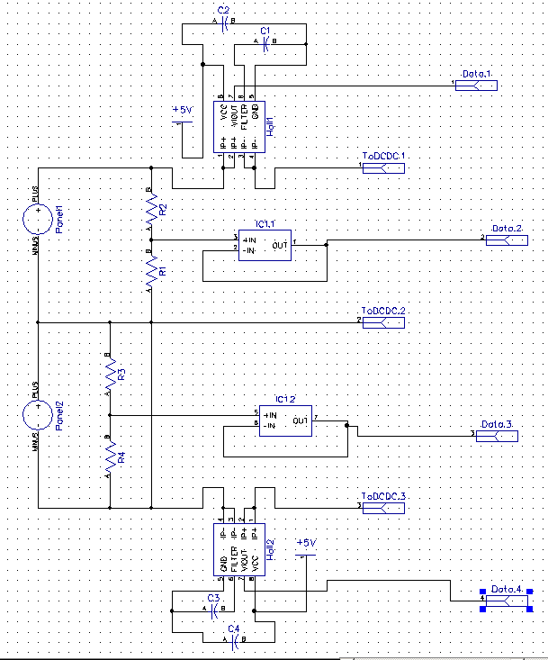
Panel V, I and T Sensors
ACS714 Hall Effect Current Sensor – 5V Supply, 1.5% error, 2.5V output, No effect on power loop.

Slide 28
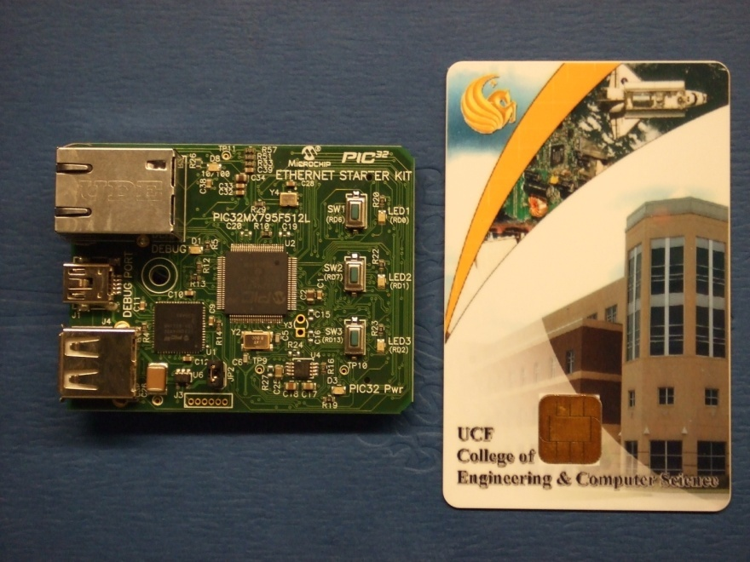
PIC32MX795F12L Ethernet Starter Kit
Flash Program Memory: 512KB
RAM: 128KB
Speed: 80MHz
Cache: 256 Byte
Power Supply: 3.3V
USB Port

Slide 29
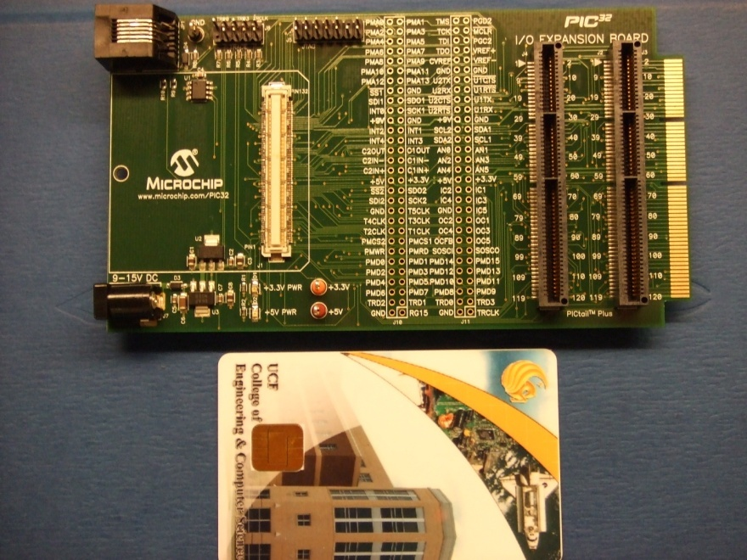
I/O Expansion Board
Starter Kit Connector
Test Point Headers for multiple pin connections
Power supply adapter connection: 9V

Slide 30
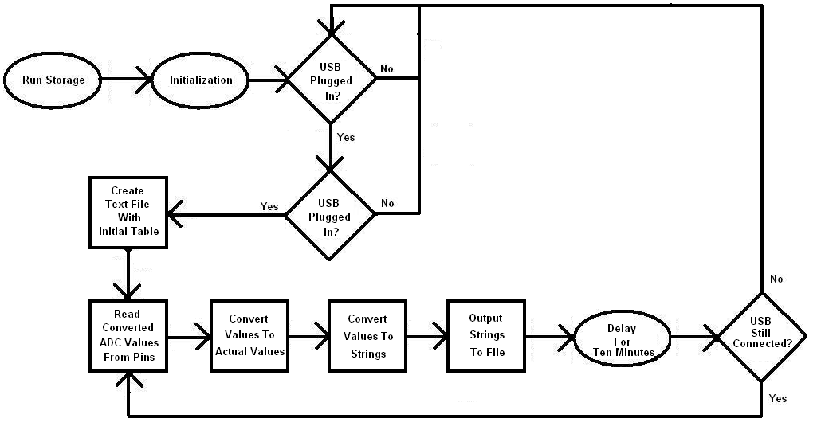
Data Storage Program Flowchart

Slide 31
Data Transmission and User Interface

Slide 32
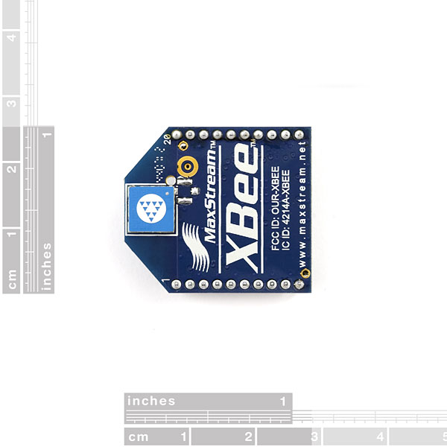
1mW Xbee Chip Antenna
Features:
3.3V @ 50mA
250kbps Max data rate
1mW output (+0dBm)
300ft (100m) range
Built-in antenna
Fully FCC certified
6 10-bit ADC input pins
8 digital IO pins
128-bit encryption
Local or over-air configuration
AT or API command set

Slide 33
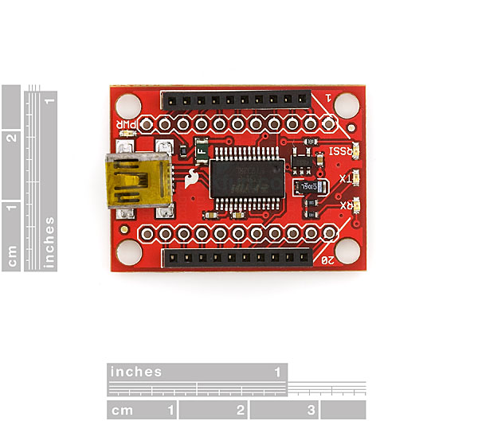
XBee Explorer USB
Features:
This is a easy to use, USB to serial base unit for the XBee line.
This unit works with all XBee modules (i.e. Series 1 and Series 2.5, standard and Pro version).

Slide 34
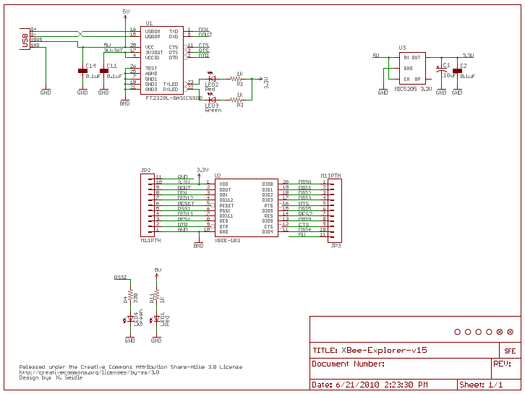
Schematic of XBee Explorer USB

Slide 35
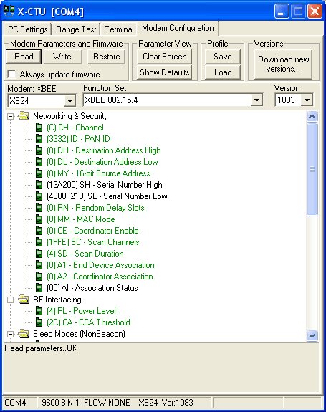
X-CTU Utility
The XBee module needs to be configured through the X-CTU utility for it to work with a PC or laptop.
The X-CTU operates only in Windows® platforms. It is not compatible with Windows® 95, Windows® NT, UNIX and Linux.

Slide 36
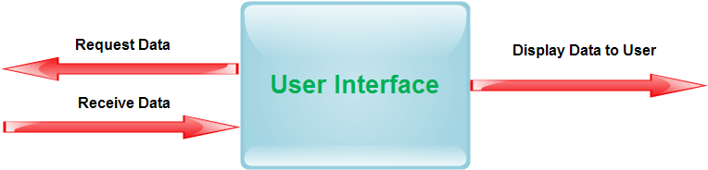
User Interface
A code written in Python programming language runs on a laptop for getting the data onto a computer.
Python script in a Windows® environment requires Python 2.7 along with other necessary Python packages
The end point XBee unit (transmitter) harvests the data, It wakes up every five minutes and will send the raw data to the XBee explorer unit which will be connected to a laptop.
The script communicates to the XBee, and the XBee will communicate over the serial port.

Slide 37
Scripting
Some of the functionalities of the script are as follows:
  Open up the serial port;
  Get data packet from the XBee module;
  Get ADC readings;
  Store data in arrays;
  Average all ADC values;
  Estimate voltage;
  Estimate current
  Calculate power from voltage and current value;
  Output voltage;
  Output current;
  Output power ;

Slide 38
General Architecture

Slide 39
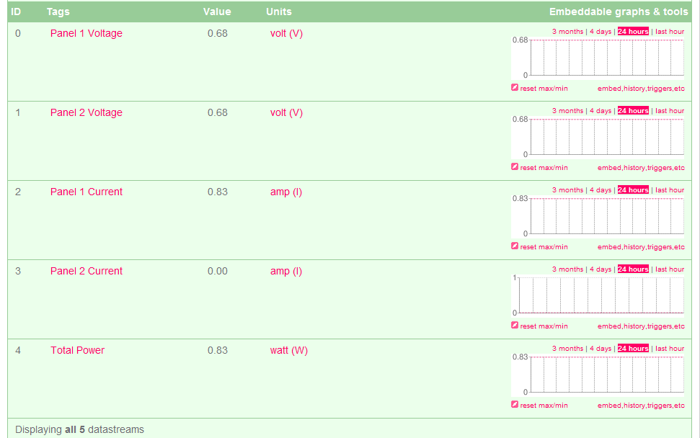
Graphs
The data gets uploaded to the website through a data feed and the real time voltage, current, and power graphs are displayed to the user.
Third party API and online database service provider.

Slide 40
Budget and Project Status

Slide 41
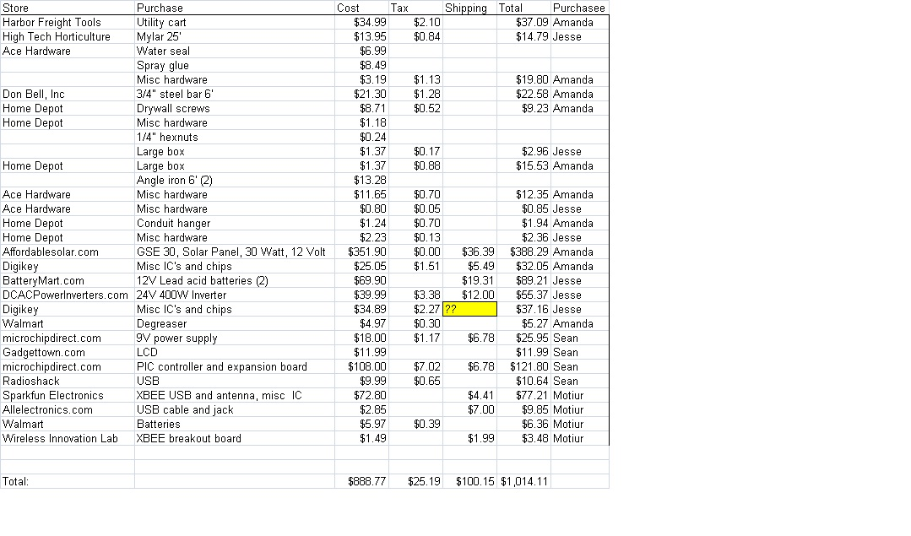
Budget Breakdown

